Slide 1


Ocean Bitemap: global and local drivers of shallow water predation intensity
Matt Whalen, Emmett Duffy, Ross Whippo, & the Bitemap Team
30 March 2018
Benthic Ecology Meeting
Corpus Christi, Texas

Slide 2
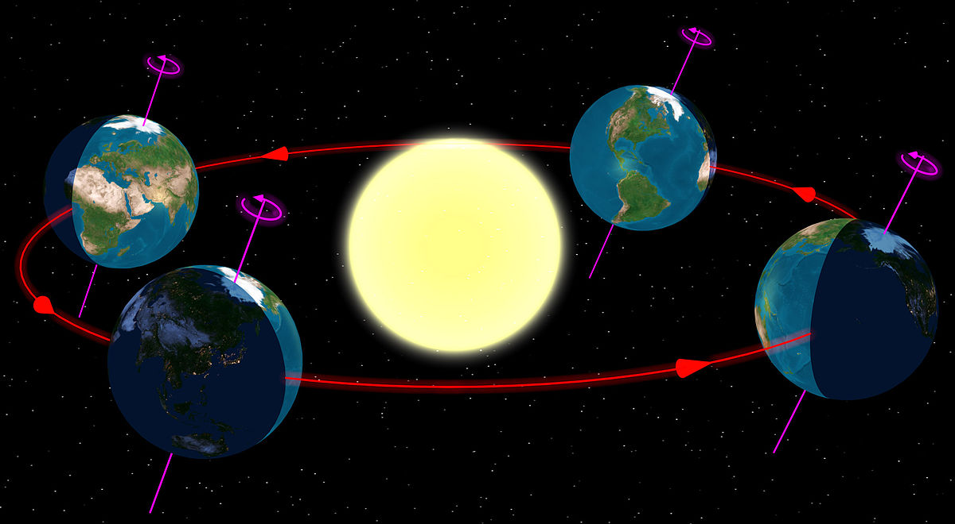
Latitudinal gradients:
some of the most studied and celebrated patterns in ecology
Ultimately driven by the Earth’s rotation and orbit around the sun
Classic gradients:
light and temperature
productivity
species diversity
interaction strength

Slide 3
Relationships among important gradients are unclear
causality, directionality, reciprocity
Productivity
Diversity
Interactions
Fundamental constraints on primary productivity are relatively well understood, but
Constraints on species interactions and diversity are less well understood (need to invoke ecology and evolution)

Slide 4
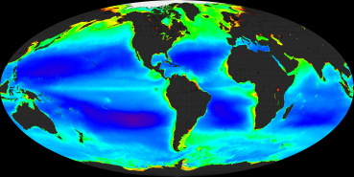
We can see primary production from space
Maps of phytoplankton and terrestrial plants help us understand what constrains primary productivity at global and regional levels
Where does this production go? Do we understand how species interactions funnel energy and materials up food webs?

Slide 5
Gradients in herbivory and predation:
Evidence for increasing species interactions toward equator
Sometimes, non-linear patterns evident
Caterpillars eating leaves on trees
Predation on amphipods ~ Latitude or Temperature
100
75
% leaf consumption
50
25
0
30
35
40
0
1
2
3
4
Latitude
Caterpillar abundance
Baskett & Schemske 2018 Ecol Lett
Reynolds et al 2018 Ecology

Slide 6
Gradients in predation:
Evidence for increasing species interactions toward equator
Evidence from marine systems:
Amy Freestone: predation influences coexistence
Gradients that signal species interactions:
Gastropod morphology: bigger, thicker shells with more ornamentation in tropics
Invertebrate body size decreases with latitude: predation or temperature/oxygen
How do we get a reliable estimate of predation intensity across the globe, given differences in prey communities?
Effect of predation on richness (cage / open)
Freestone et al 2011 Ecology

Slide 7
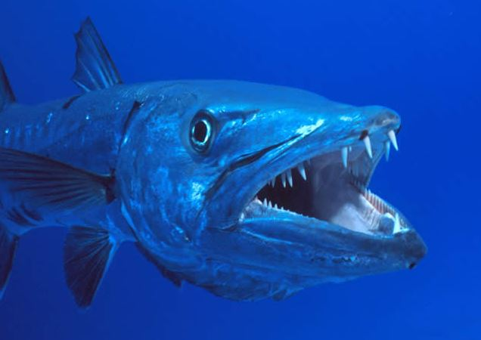
Bitemap: a globally resolved map of predation intensity using standardized methods
Consumption is what moves energy and materials through food webs, so measuring consumption across space will tell us about trophic transfer
Predation, fisheries production
Abiotic gradients
Primary production

Slide 8
Bitemap: what should it look like?
Perhaps predation rates should mirror patterns of fish abundance and diversity
Predation likely influenced directly by temperature as consumption is a temperature-dependent process
Hypothesis: monotonic increase in predation pressure with decreasing latitude / mean temperature
Edgar et al 2017 Sci Adv

Slide 9
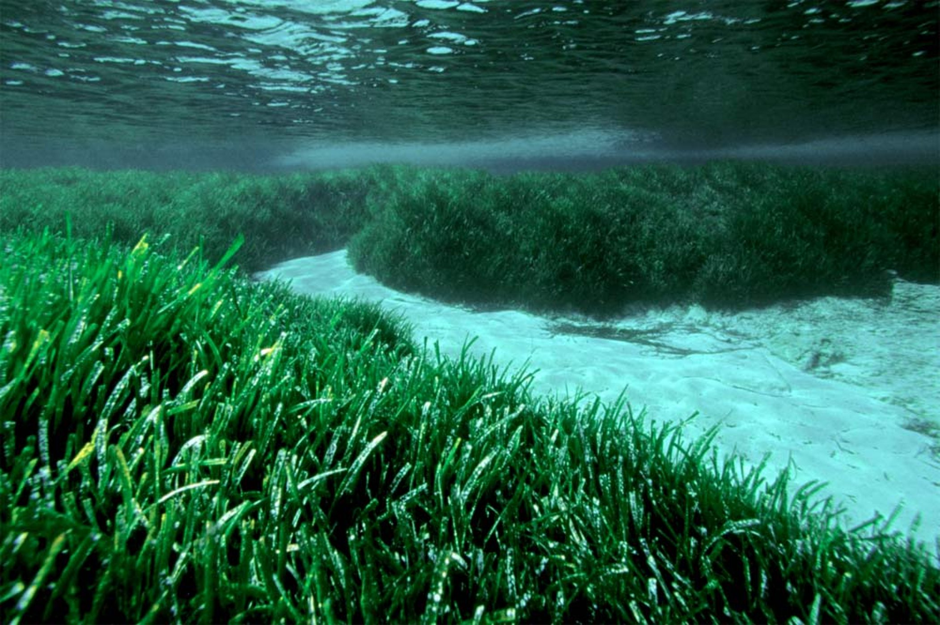

Bitemap: what should it look like? Influence of physical structure?
Effect of physical structure on predation can be difficult to predict.
Predation can be lower or higher in vegetated habitats like seagrasses, but this is complicated by a number of factors:
density of vegetation
predator/prey composition
body size + other functional traits of predators and prey
M San Felix

Slide 10
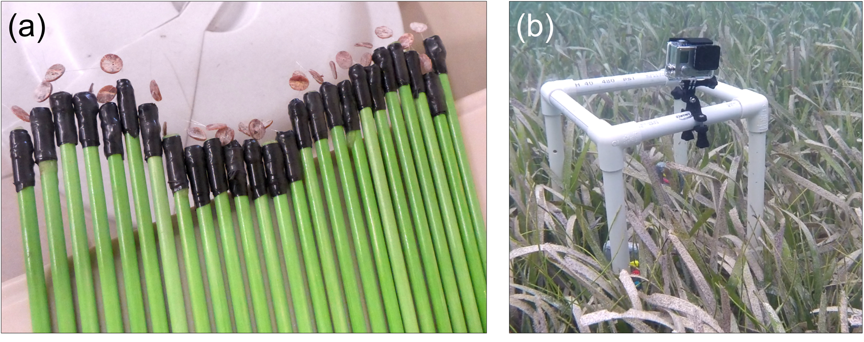
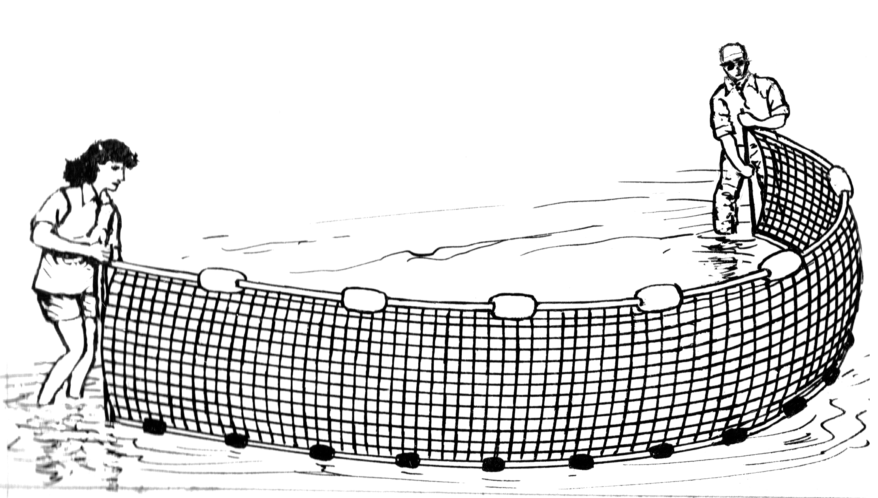
Methods: Squidpops + Predator surveys
Squidpops
25 squidpops each in seagrass and unvegetated habitats
repeated three times
presence/absence of squid measured at 1 and 24 hours
exponential decay of squidpops over time as predation rate
GLMMs on rates (logit link)
Predator surveys
coupled seining and/or video
predator abundance, biomass, diversity FROM SEINES
use traits to select taxa
Duffy et al 2015 PLoS ONE

Slide 11
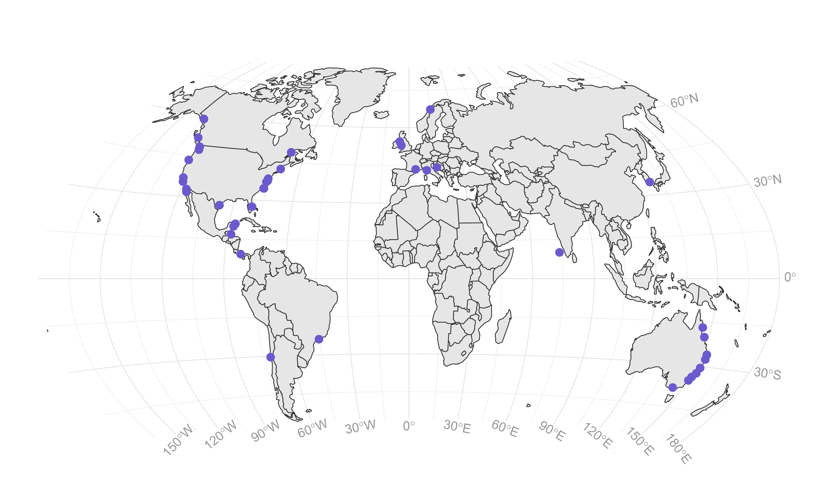
Bitemap: 2016 and 2017 efforts
40 sites across 105 degrees of latitude
seagrass vs unvegetated habitat (n=37)
strong gradients in temperature (annual mean and instantaneous)
14 species of seagrass (dominated by Zostera, 4 species max at one site)

Slide 12
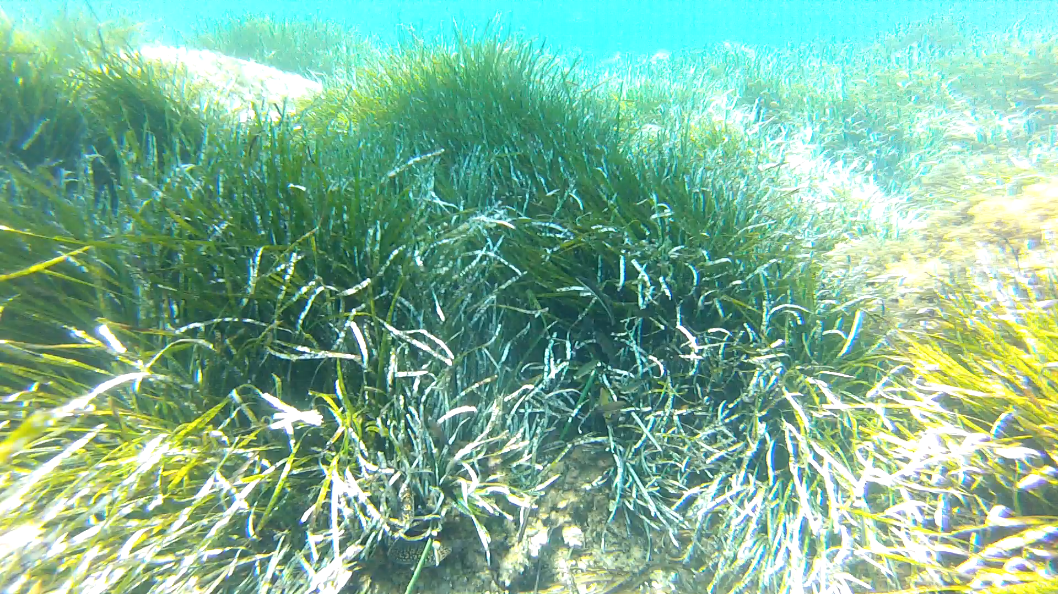
Mediterranean Posidonia bed
Lisandro Benedetti-Cecchi

Slide 13
Fish abundance, biomass, and diversity all higher in seagrass, on average

Slide 14
Fish abundance increases with annual mean temperature
But, fish biomass declines at highest temperatures
Note: both abundance and biomass on a log scale

Slide 15
Apparent drop in predation rate at lowest latitudes/average temps

Slide 16
Apparent drop in predation rate at lowest latitudes/average temps
Model comparison: AIC supports quadratric effect of mean annual SST
Modest influence of vegetation at this scale (slightly higher in seagrass, on average)

Slide 17
In situ (measured) temperature showed monotonic pattern
Predation rate on squidpops increases with temperature and biomass (additively)

Slide 18
In situ (measured) temperature showed monotonic pattern
Predation rate on squidpops increases with temperature and biomass (additively)

Slide 19
In situ (measured) temperature showed monotonic pattern
Predation rate on squidpops increases with temperature and biomass (additively)

Slide 20
Not a clear relationship between long-term range in SST and predation

Slide 21
In situ (measured) temperature showed monotonic pattern
Predation rate on squidpops increases with temperature and biomass (additively)

Slide 22
Conclusions
Predation rates are influenced by global-scale gradients in temperature, but it does not appear to be monotonic when consider annual means
the most tropical sites did not have the highest predation rates
Predation is influenced by local conditions
predation tended to be higher in seagrass habitats
abundance, diversity, and biomass of predators explain habitat result
Relative importance of temperature is slightly stronger, but predator biomass adds explanatory value

Slide 23
Acknowledgements
We thank all of the PIs, technicians, and students around the world who made this work possible and continue to collaborate on this project
Funding for this work provided by MarineGEO and the Hakai Institute

